Slide 1


Face Recognition
BTP Interim Progress Review,
Department of Computer Science & Engineering, IIT Jodhpur
Team Member 1: Sohail Khan (B16CS036)
Team Member 2: Harshul Sharma (B16ME011)
Guide: Dr. Chiranjoy Chattopadhyay
Department of Computer Science and Engineering

Slide 2
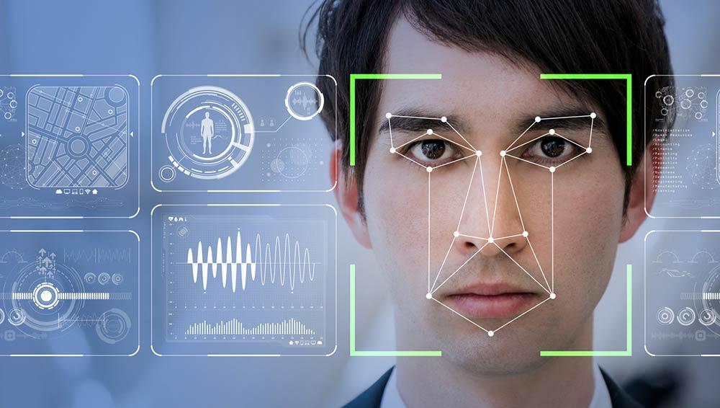
FACE RECOGNITION
Interpolation

Slide 3
Practical Applications
Security : face recognition allows security companies to monitor suspicious persons. Faces are compared with large databases and authorities are alerted if there is a match.
Authorisation: Face recognition is used as a feature for authorization. Users can unlock their phones and laptops using the feature.
Social Network: Face recognition is used by many social networking platforms like facebook uses it to automatically tagging people in a photo. Instagram and snapchat use it for their face filters.
Biometrics: Face recognition is used by many companies to keep track of their employees attendance .It is also used in schools and colleges for tracking students attendance.
Transaction: MasterCard is planning to use face recognition instead of passwords for allowing users to complete their transaction.

Slide 4



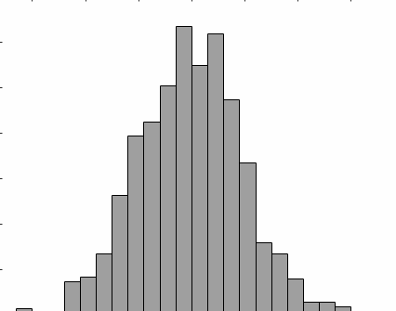


FLOW DIAGRAM
Gray image
Face
detection
Face obtained
Interpolation
Feature extraction
Comparing against known
feature vectors
(faces)
user
Make
prediction
Using KNN
L1 distance
Face
Recognition
Feature Vector obtained using
LDRP
Database

Slide 5


Detection and Preprocessing
Image is resized and converted to grayscale before sending it to Face Detectors.
OpenCv has 3 major face detectors - haarcascade_alt, haarcascade_alt2, LBP_facecascade.
Haarcascade_alt2 is used in the project as it gave best output for the given databases.
Input to
LDRP
Face image
Following algorithm is implemented for feature vector calculation from obtained face image:
Local Directional Relation Pattern for Unconstrained and Robust Face Retrieval , Shiv Ram Dubey

Slide 6
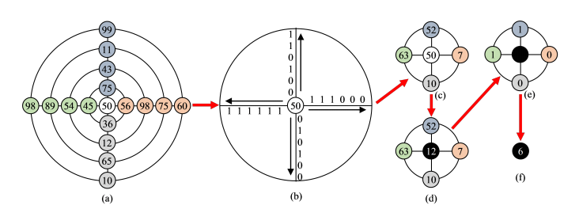
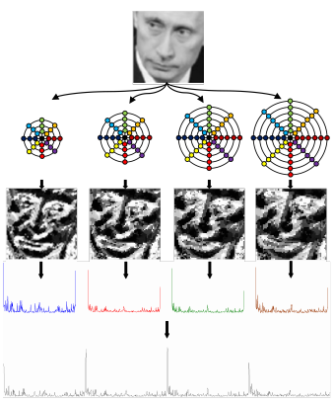
LDRP
Central pixel transformation
(N=4 ,M=4)
Local Directional Relation Pattern
feature vector computation
N - No. of directions
M - No. of neighbors considered

Slide 7
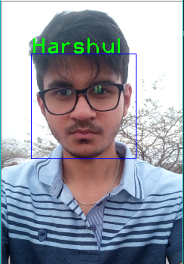

Face Recognition
compute distances from each feature vector
KNN
feature vector
(LDRP output)
Database of Trained faces (feature vector)
Face
Recognition
Kth nearest neighbor is used to find the closest K neighbors.

Slide 8
Datasets
Datasets | Training Images | Testing Images | Correct Matches
Faces94 | 848 | 152 | 151
Faces95 | 450 | 130 | 123
AT&T | 280 | 120 | 115

Slide 9
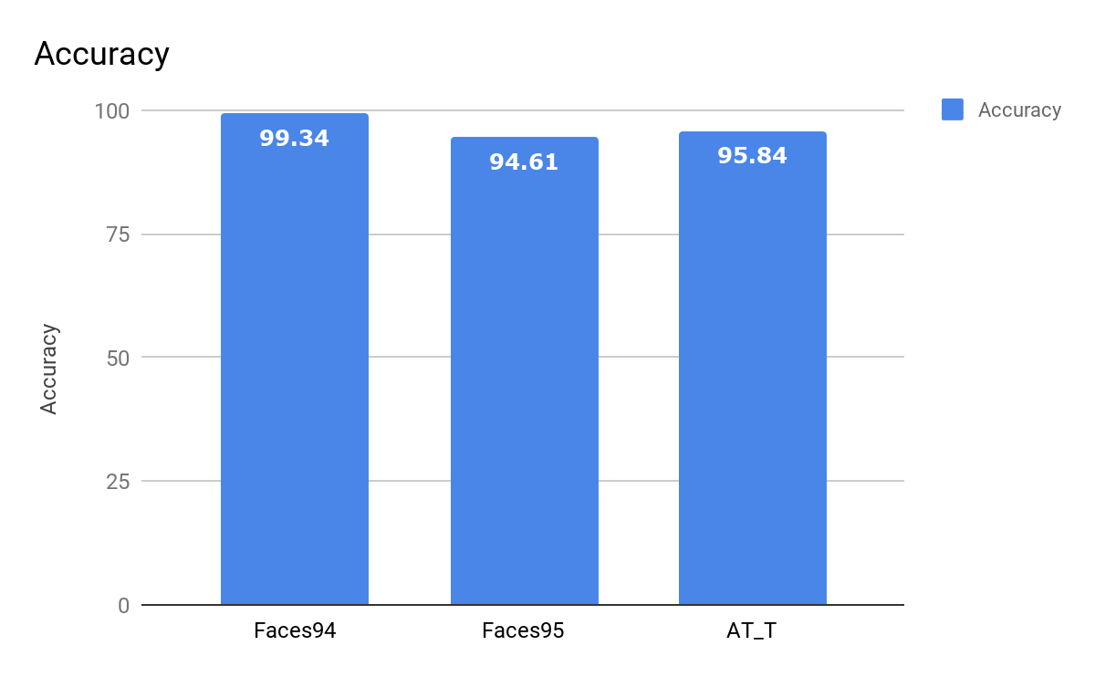
Results

Slide 10
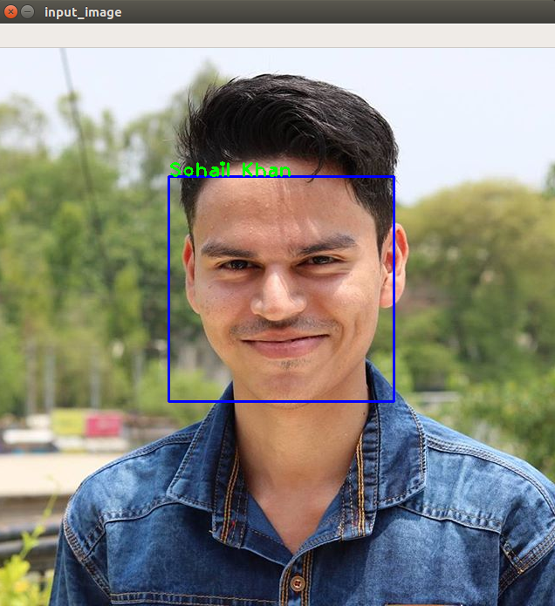
CHALLENGES : SIZE VARIATIONS
Image Shrinkage causes loss of information.
DATA LOSS occurs during shrinkage
Correct Match
Wrong Match
Interpolation
Interpolation
Shrinkage
Shrinkage
Thus, very judicious preprocessing needs to be done!!
The Interpolation used is cv2.INTER_AREA

Slide 11
Comparison with Existing
Descriptors
Existing descriptors: LBP, LDP, LDGP, LGHP.
Feature vector dimensions = 256, 1024, 512, 9216, respectively.
Dimension of LDRP feature vector = 1024, and is independent of size of image, unlike HOG.
LGHP also works on similar principle, but the maths included and the size of feature vector decreases the time and space efficiency significantly.

Slide 12
Demonstration

Slide 13
References
Soumendu Chakraborty; Satish Kumar Singh; Pavan Chakraborty, Local Gradient Hexa Pattern: A Descriptor for Face Recognition and Retrieval, IEEE Transactions on Circuits and Systems for Video Technology, Volume: 28, Issue: 1, Jan. 2018.
Shiv Ram Dubey, Local Directional Relation Pattern for Unconstrained and Robust Face Retrieval, arXiv:1709.09518, 2017.
Haar Cascade, OpenCV: https://docs.opencv.org/2.4/index.html
HOG: https://www.learnopencv.com/histogram-of-oriented-gradients/
LBP: ​ https://ieeexplore.ieee.org/document/7322425/

